Slide 1

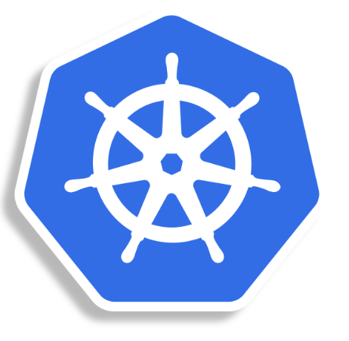
MASTER-ACADEMY
Container Orchestration using
Kubernetes Part - 1
Week 4
DevOps Boot Camp 2021

Slide 2
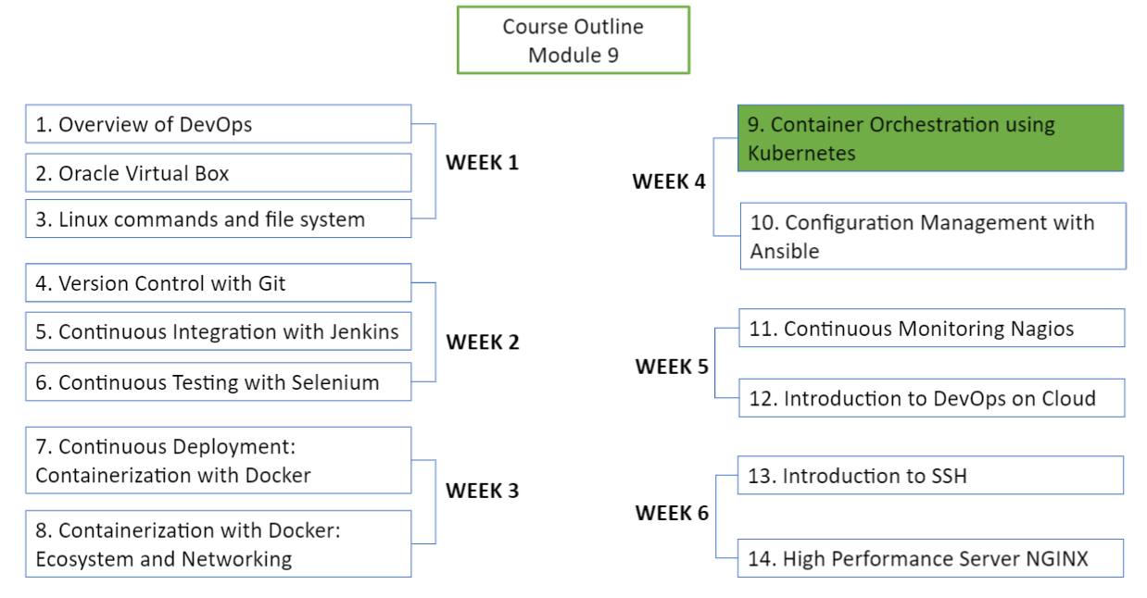
MASTER-ACADEMY
DevOps Boot Camp 2021

Slide 3

Topics
MASTER-ACADEMY
Part - 1
Container Orchestration Concept
Introduction to Kubernetes
Features and Advantages of Kubernetes
Creating a Kubernetes Cluster
Part - 2
Deployment in Kubernetes
Services in Kubernetes
Rolling updates in Kubernetes
Kubernetes Dashboard
DevOps Boot Camp 2021

Slide 4
Objectives
MASTER-ACADEMY
Understand the basics of Kubernetes
Understand Kubernetes Architecture
Set up a Kubernetes Cluster on Ubuntu VMs
Deploy your first app on Kubernetes using YAML file
Deploying an On-Prem application on Kubernetes using Dashboard
Update your application Pod using a Blue Green Deployment on Kubernetes
DevOps Boot Camp 2021

Slide 5
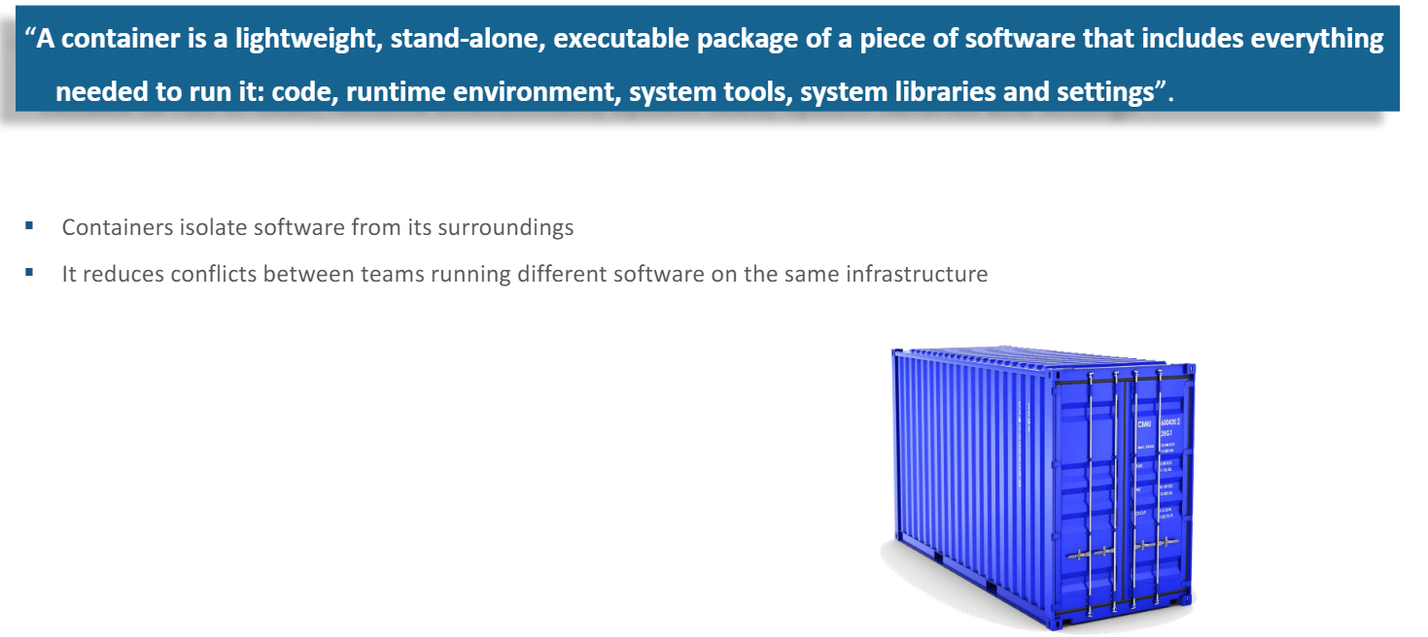
Revisiting Containers
MASTER-ACADEMY
DevOps Boot Camp 2021

Slide 6
Why Container Orchestration?
MASTER-ACADEMY
Container orchestration manages the availability, scaling and networking of containers
It helps in monitoring the cluster i.e., group of hosts
It helps in managing the timing of container creations
It helps in container configuration in order to allow containers to communicate with one another
DevOps Boot Camp 2021

Slide 7
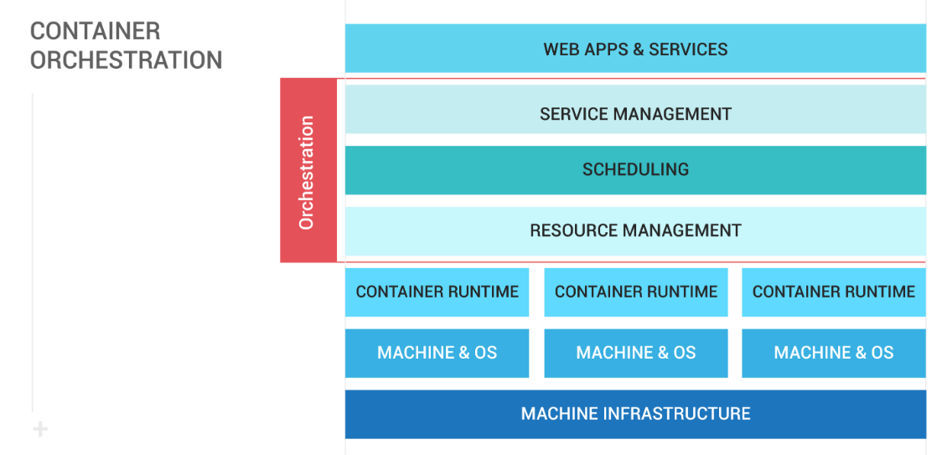
Container Orchestration
MASTER-ACADEMY
DevOps Boot Camp 2021

Slide 8
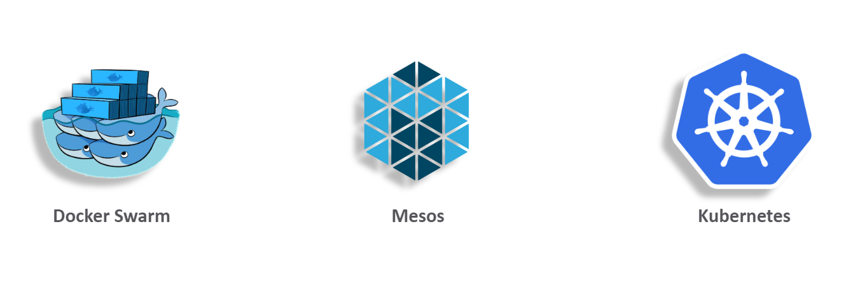
Top 3 Container Orchestrators
MASTER-ACADEMY
DevOps Boot Camp 2021

Slide 9
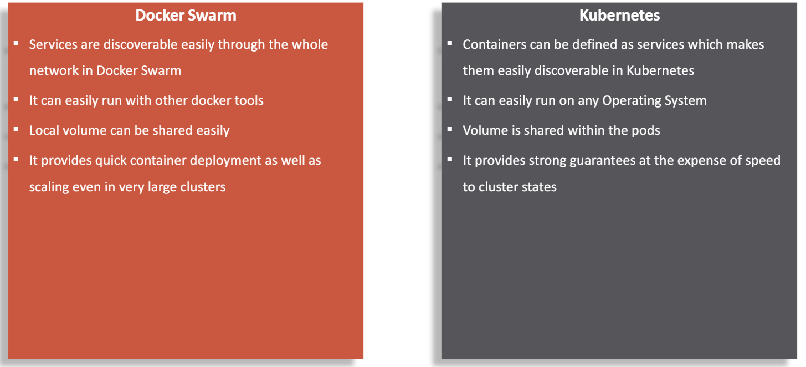
Docker Swarm Vs Kubernetes
MASTER-ACADEMY
DevOps Boot Camp 2021

Slide 10
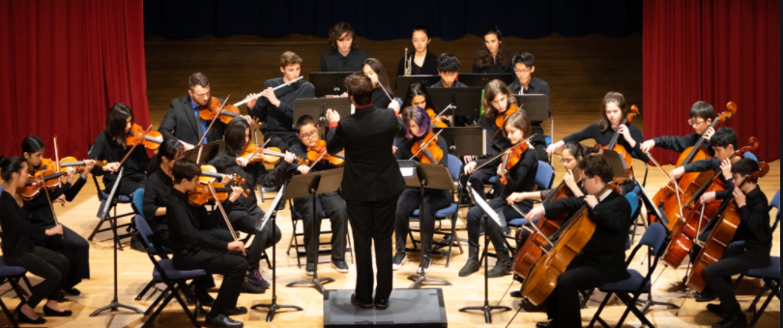
What is Kubernetes
MASTER-ACADEMY
Kubernetes is an open source orchestration system which is used for:
Deployment of containerized application
Scaling of containerized application
Management of containerized application
Kubernetes enables to:
Run multiple containers on a single machine
Schedule containers on cluster of machines
Run log running services such as web applications
DevOps Boot Camp 2021

Slide 11
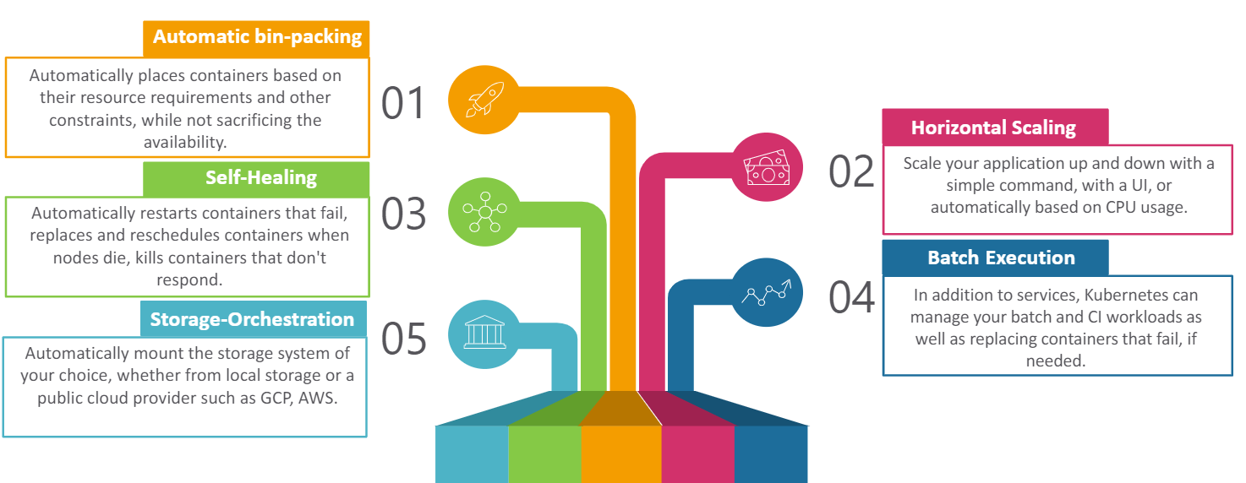
Features of Kubernetes
MASTER-ACADEMY
DevOps Boot Camp 2021

Slide 12
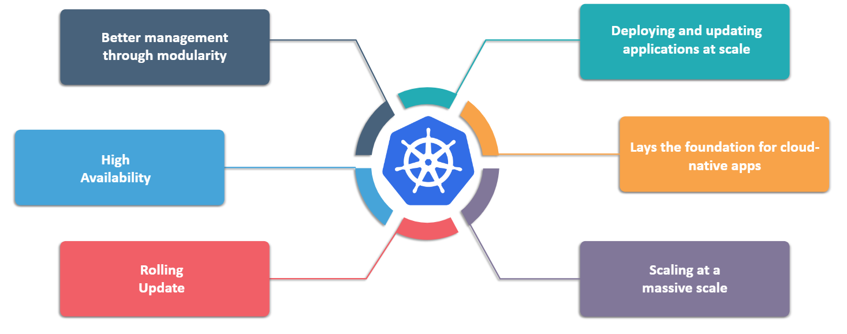
Advantages Of Kubernetes
MASTER-ACADEMY
DevOps Boot Camp 2021

Slide 13
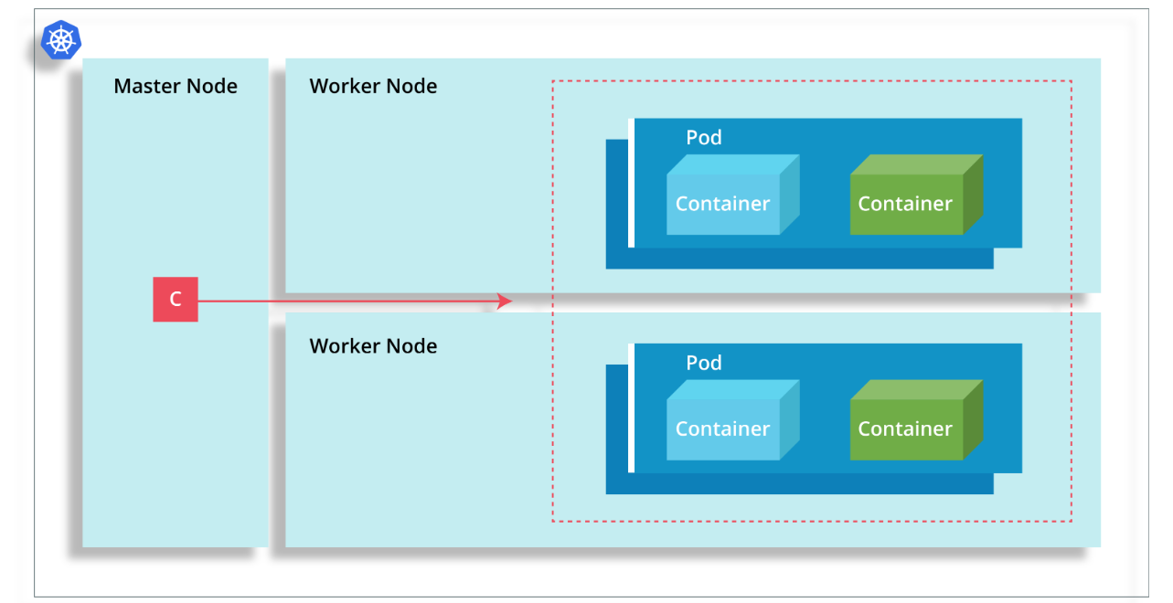
Kubernetes Cluster Architecture
MASTER-ACADEMY
DevOps Boot Camp 2021

Slide 14
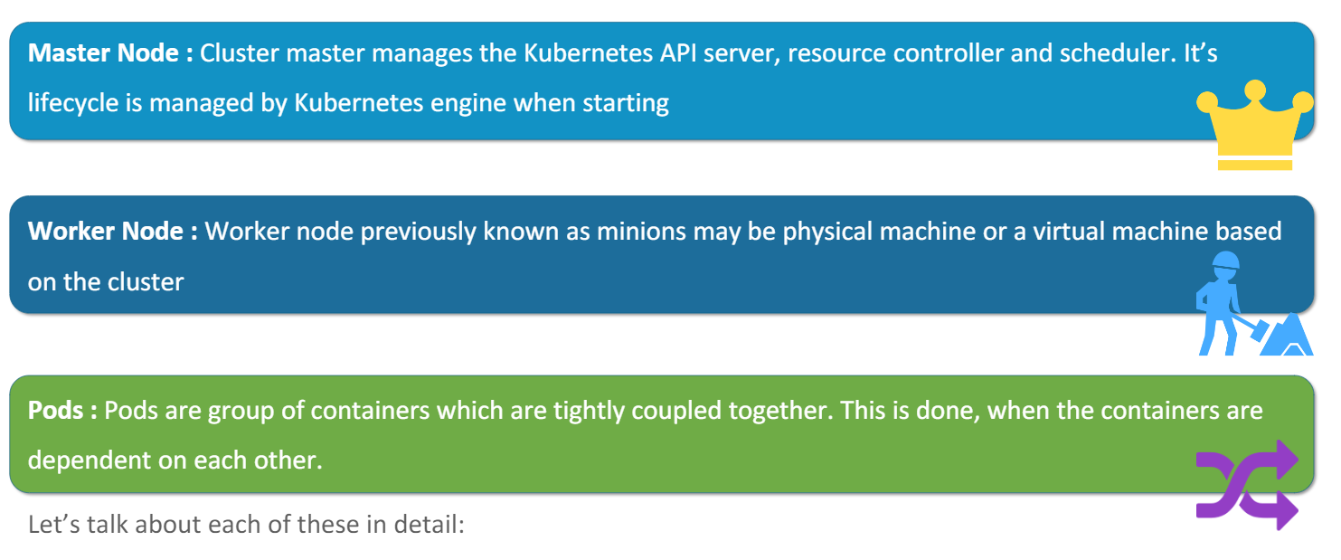
Kubernetes Cluster Components
MASTER-ACADEMY
DevOps Boot Camp 2021

Slide 15
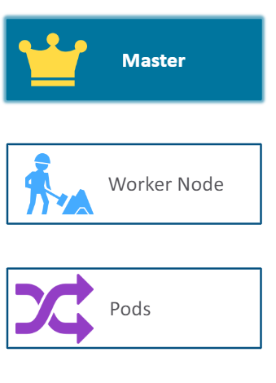
Kubernetes Master
MASTER-ACADEMY
Kubernetes master is a collection of four processes:
Kube API Server: It validates and configures all the data for the API objects which include pods, servies, replica controllers and others
Kube controller manager: It’s a daemon that includes the non terminal loops (that regulates the state of the system) shipped with Kubernetes
Etcd: It is a distributed key-value store designed to reliably and quickly preserve and provide access to critical data
Kube scheduler: The Kubernetes Scheduler is a workload-specific function that significantly impacts availability, performance, and capacity. Workload-specific requirements will be exposed through the API as required
DevOps Boot Camp 2021

Slide 16
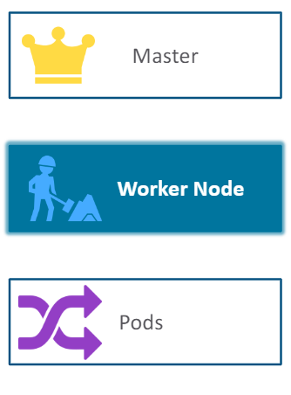
Kubernetes Worker Node
MASTER-ACADEMY
Worker node in the cluster runs three processes:
Kubelet: It’s a foremost node agent running on each node works under the terms of PodSpec. A PodSpec is a YAML or JSON object that describes a pod
Kube Proxy: Kubernetes network proxy runs on each node
Container Runtime: The container runtime is the software that is responsible for running containers. Kubernetes supports several runtimes: Docker, rkt, runc and OCI runtime spec implementation
DevOps Boot Camp 2021

Slide 17
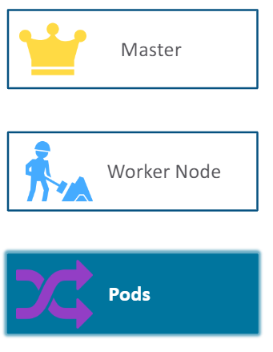
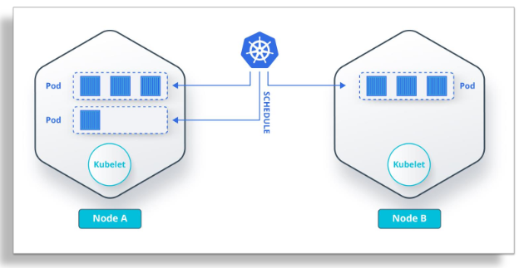
Kubernetes Pods
MASTER-ACADEMY
Containers are deployed and scheduled through Kubernetes in a group called pods
These are tightly coupled containers i.e the application running on them are dependent on each other
1 to 5 tightly coupled containers can be stored in a pod that collaborate to provide a service. This is called micro service
DevOps Boot Camp 2021

Slide 18
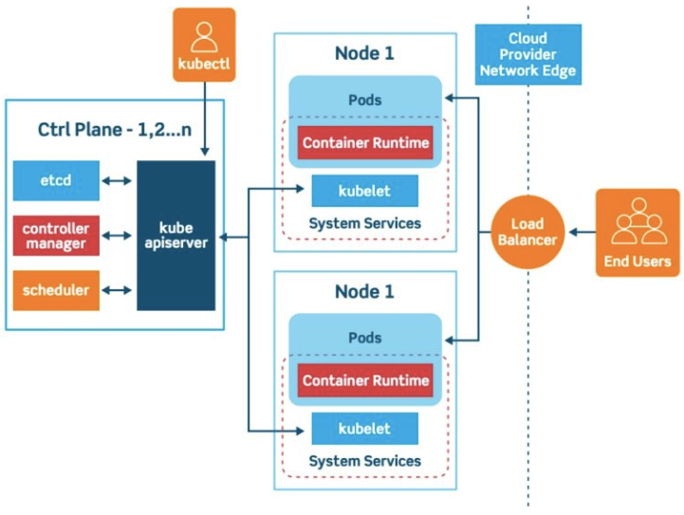
Inside a Kubernetes Cluster
MASTER-ACADEMY
DevOps Boot Camp 2021

Slide 19
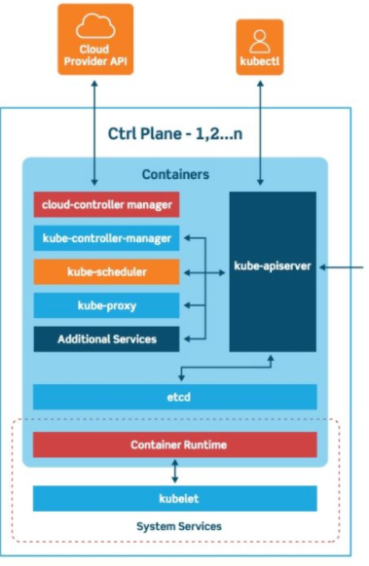
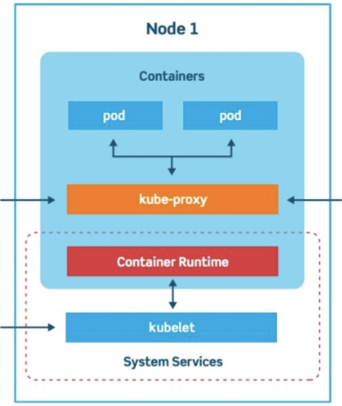
Control Plane and Cluster Node
MASTER-ACADEMY
DevOps Boot Camp 2021

Slide 20
Setting Up a Cluster
MASTER-ACADEMY
First need to spin up 3 VMs using any cloud service such as AWS or using VirtualBox
Need to install docker on all 3 machines which provides the container runtime environment
Install Kubeadm which bootstrap a new cluster
Once Kubeadm is installed initialize the master
Install a Pod network configuration, for this demo we will install flannel
Once Pod is running join the node to the master
DevOps Boot Camp 2021

Slide 21
Installing Docker on all 3 Machines
MASTER-ACADEMY
First need to update the package list in all 3 machines
sudo apt-get update
Next install Docker on all 3 machines
sudo apt-get install docker.io
Next check the version of Docker on all 3 machines
docker ––version
Next set Docker to launch at boot in all 3 machines
sudo systemctl enable docker
Next verify if Docker is running on all 3 machines
sudo systemctl status docker
DevOps Boot Camp 2021

Slide 22
Install Kubernetes in all 3 Machines
MASTER-ACADEMY
Since you are downloading Kubernetes from a non-standard repository, it is essential to ensure that the software is authentic. This is done by adding a signing key
echo "deb http://apt.kubernetes.io/ kubernetes-xenial main" | sudo tee /etc/apt/sources.list.d/kubernetes.list
curl -s https://packages.cloud.google.com/apt/doc/apt-key.gpg | sudo apt-key add
Since Kubernetes is not included in the default repo, add software repo:
sudo apt-add-repository "deb http://apt.kubernetes.io/ kubernetes-xenial main"
Enter the following commands to install KUBEADM, KUBELET, KUBECTL:
sudo apt-get install kubeadm kubelet kubectl
sudo apt-mark hold kubeadm kubelet kubectl
Verify the installation:
kubeadm version
DevOps Boot Camp 2021

Slide 23
Kubernetes Deployment
MASTER-ACADEMY
In order to start Kubernetes deployment start by disabling swap memory for each server:
sudo swapoff –a
Assign unique hostname for each server node or machine:
sudo hostnamectl set-hostname master-node
sudo hostnamectl set-hostname worker01
sudo hostnamectl set-hostname worker02
Initialize Kubernetes on Master Node ONLY. Please note cidr 10.244.0.0/16 is designated for Flannel network. This network is required for Pods to communicate with each other.
sudo kubeadm init --pod-network-cidr=10.244.0.0/16 --ignore-preflight-errors=all
Please copy the printout kubeadm join command (at the end of the printout) for later use. This command is unique to each cluster and will be used for joining other nodes to the cluster. Need to run the following commands to complete deployment on Master node:
mkdir -p $HOME/.kube
sudo cp -i /etc/kubernetes/admin.conf $HOME/.kube/config
sudo chown $(id -u):$(id -g) $HOME/.kube/config
DevOps Boot Camp 2021

Slide 24
Deploy Pod Network to Cluster
MASTER-ACADEMY
A Pod Network is a way to allow communication between different nodes in the cluster. This tutorial uses the flannel virtual network. Enter the following command on Master node:
kubectl apply -f https://raw.githubusercontent.com/coreos/flannel/master/Documentation/kube-flannel.yml
Allow the process to complete and verify that everything is running and communicating:
kubectl get pods --all-namespaces
The coredns should be up and running
DevOps Boot Camp 2021

Slide 25

Join Worker Node to Cluster
MASTER-ACADEMY
Check the nodes on the current cluster by running the following command in Master node:
kubectl get nodes
As mentioned in the earlier steps (see Kubernetes deployment), now kubeadm join command can be used in each worker node to connect them to the cluster. Run the command on each Worker node (the token part is excluded, since your token and IP should be unique):
sudo kubeadm join 172.31.x.x:6443 --token
Now run the “kubectl get nodes” on the Master node to check node status
kubectl get nodes
DevOps Boot Camp 2021

Slide 26
End of Part 1
MASTER-ACADEMY
Practice creating a Kubernetes Cluster on your Linux Environment
Go through the following link for a better understanding of concept
https://platform9.com/blog/kubernetes-enterprise-chapter-2-kubernetes-architecture-concepts/
DevOps Boot Camp 2021

